Slide 1
Coreference Resolution
Jurafsky and Martin Chapter 22
based on the textbook and Chris Manning’s CS224n slides
Notes:
Suggested readings -
Chris Manning’s slide https://web.stanford.edu/class/cs224n/slides/cs224n-2019-lecture16-coref.pdf
Understanding the Value of Features for Coreference Resolution by Bengtson and Roth: https://www.aclweb.org/anthology/D08-1031.pdf

Slide 2
Coreference Resolution
The task of determining whether two mentions corefer (i.e. refer to the same entity in the real world)
Victoria Chen, CFO of Megabucks Banking, saw her pay jump to $2.3 million, as the 38-year-old became the company’s president. It is widely known that she came to Megabucks from rival Lotsabucks.
Notes:
example taken from the textbook
Image link: https://ya-webdesign.com/image/png-business-woman/482178.html
Maybe highlight here that – this can be done even if the referent (Victoria Chen) is fictional. (Anaphora vs. Coreference)

Slide 3
Coreference Resolution
The task of determining whether two mentions corefer (i.e. refer to the same entity in the real world)
Victoria Chen, CFO of Megabucks Banking, saw her pay jump to $2.3 million, as the 38-year-old became the company’s president. It is widely known that she came to Megabucks from rival Lotsabucks.
*You know these refer to the same entity, even if they don’t exist in the real world!
Notes:
https://www.clipart.email/clipart/company-building-clipart-png-21046.html

Slide 4
Example from https://chatbotslife.com/coreference-resolution-for-chatbots-f49a720c428b
Notes:
https://chatbotslife.com/coreference-resolution-for-chatbots-f49a720c428b

Slide 5
More challenging cases…
The “Winograd Schema Challenges”
The city council denied the demonstrators a permit
because
[they]
feared
violence.

Slide 6
More challenging cases…
The “Winograd Schema Challenges”
The city council denied the demonstrators a permit
because
[they]
feared
violence.
advocated

Slide 7
Linguistics Background...
Anaphora: Reference in a text (“anaphor”) to an entity that has been previously introduced (“antecedent”)
Barack Obama said he would sign the bill.
Antecedent
Anaphor
Example borrowed from Manning’s CS224n slides..
Notes:
https://web.stanford.edu/class/cs224n/slides/cs224n-2019-lecture16-coref.pdf

Slide 8
Anaphora vs. Coreference
- Coreference with Named Entities (a.k.a. Entity Linking)
text
Barack Obama
Obama
Real world
Example borrowed from Manning’s CS224n slides..
Notes:
https://web.stanford.edu/class/cs224n/slides/cs224n-2019-lecture16-coref.pdf

Slide 9
Anaphora vs. Coreference
- Anaphora Resolution
text
Barack Obama
he
Real world
Example borrowed from Manning’s CS224n slides..
Notes:
https://web.stanford.edu/class/cs224n/slides/cs224n-2019-lecture16-coref.pdf

Slide 10
Coref. Resolution Pipeline
Step 1. Mention Detection
Step 2. Clustering Corefering Mentions
*Not the only way to do it… As we will show later in class

Slide 11
Coref. Resolution Pipeline
Step 1. Mention Detection
Step 2. Clustering Corefering Mentions

Slide 12
Mention Detection
Usually¹ done with existing NLP systems.
Three different types of mentions:
1. Noun Phrases (NP)
- Constituency parser or Chunker (shallow parser)
2. Named Entity
- Named Entity Recognition (NER) System
3. Pronoun
- POS tagger
¹ To get the best performance, you might want to consider training a separate mention detector if you have enough training data, as there are scenarios where the three types couldn’t cover all the mentions. Refer to Jurafsky & Martin §22.3 for more details.

Slide 13
Coref. Resolution Pipeline
Step 1. Mention Detection
Step 2. Clustering Corefering Mentions

Slide 14
Popular Architectures*
Mention-Pair
Predict whether a pair of mention is corefering or not
Mention-Rank
For each anaphor, rank the candidate antecedents (and choose the highest scoring one)
* We only cover the two nowadays popular and relevant architectures as example. Refer to the book for more architectures.

Slide 15
Popular Architectures
Mention-Pair
Predict whether a pair of mention is corefering or not
Mention-Rank
For each anaphor, rank the candidate antecedents (and choose the highest scoring one)

Slide 16
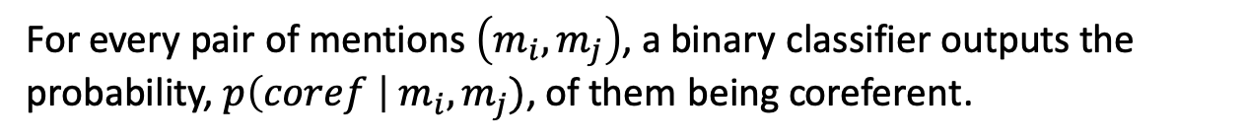
Mention-Pair Architecture
For every pair of mentions $\left(m_{i}, m_{j}\right)$, a binary classifier outputs the probability, $p\left(coref \right| m_{i}, m_{j})$, of them being coreferent.
Tune a threshold $θ$ on so that classifier predicts “coref” when $p>θ$
Victoria Chen
Megabucks Banking
The 37-year-old
She
her
Candidate Antecedents
Anaphor

Slide 17
Mention-Pair Architecture
But wait… How do we turn pairwise decisions/scores into clusters?
Easy solution – take transitive closure
(fails on false positives)
She
Victoria Chen
The 37-year-old
Victoria Chen
The 37-year-old
She
Megabucks Banking
Megabucks Banking
Megabucks
Megabucks
More sophisticated solution – DBSCAN
(no need to specify # of clusters before hand)

Slide 18
Popular Architectures
Mention-Pair
Predict whether a pair of mention is corefering or not
Mention-Rank
For each anaphor, rank the candidate antecedents (and choose the highest scoring one)

Slide 19
Mention-Rank Architecture
Unlike mention-pair, we only ask the model to predict the most likely antecedent of each anaphor.
Makes more sense, as many mentions only have one clear antecedent.
This way we will have a high precision model (fewer false positives), which makes clustering easier as well.
Score=0.95
0.6
0.7
Victoria Chen
Megabucks Banking
The 37-year-old
She
her
0.1
Candidate Antecedents
Anaphor

Slide 20
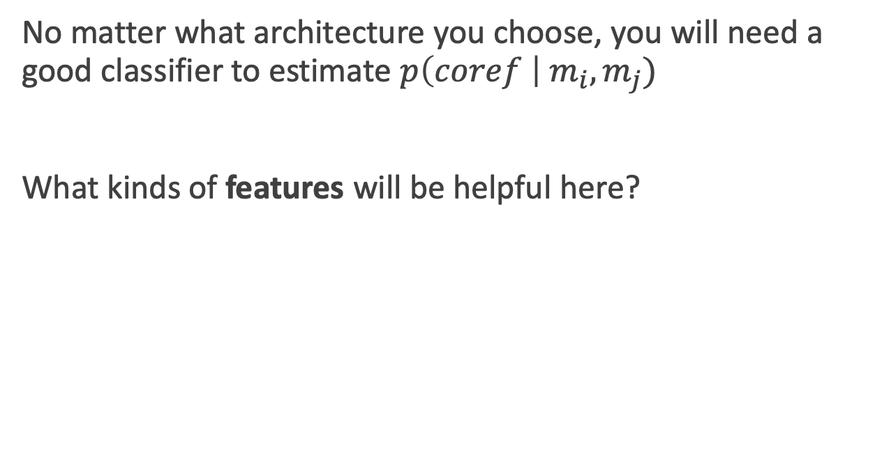
How do we build the classifier?
No matter what architecture you choose, you will need a good classifier to estimate $p\left(coref \right| m_{i}, m_{j})$
What kinds of features will be helpful here?

Slide 21
Feature-based Classifier
There are a number of high precision constraints/features we can think of…
Gender Match | Jack asked Lucy for a favor. She accepted.
Number Match | A dog is chasing after two cats… They are exhausted.
Syno/Hyper-nymy | The plane flew over Philly… The aircraft…
Entity Type | Megabucks appointed Mrs. Chen as…. The company…
Both Speaker | John said that Jim is… He also mentioned…
… | …
“Understanding the value of features for coreference resolution”, Bengtson and Roth (2008)

Slide 22
Feature-based Classifier
Classifiers learned over conjunctions of these features has been proven to be effective
Disadvantage: Most features are heavily handcrafted.
Can we use neural models instead? But most features we saw so far are not differentiable…

Slide 23
The neural approach
A mention-rank model (choose most likely antecedent only)
“End to End”: Mention Detection and Coref. Resolution in one single step.
Consider every span up to length k (i.e. n-grams) as candidate mention.
“End-to-end Neural Coreference Resolution”, Lee et. al. (2017)
Notes:
The weight wi for each entity can be set to different values to produce different versions of the algorithm.

Slide 24
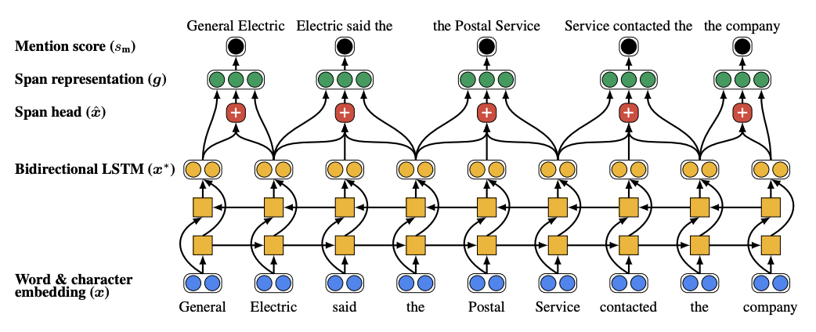
First step – Candidate Pruning
Score the spans and prune the low scoring ones (unlikely to be a valid mention)
Leaving manageable number of spans for second step
“End-to-end Neural Coreference Resolution”, Lee et. al. (2017)

Slide 25
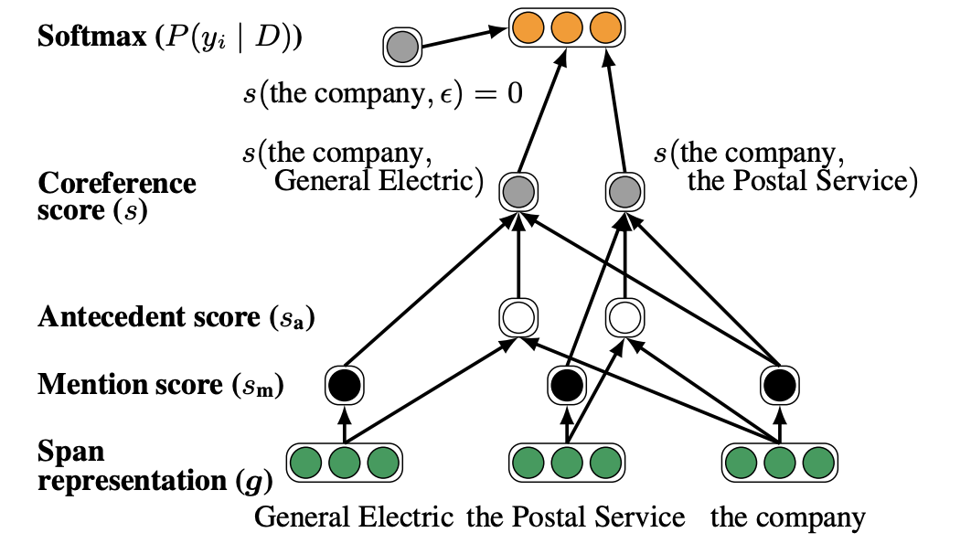
Second step: Coref. Score
Compute pairwise Coref. score on span candidates
“End-to-end Neural Coreference Resolution”, Lee et. al. (2017)

Slide 26
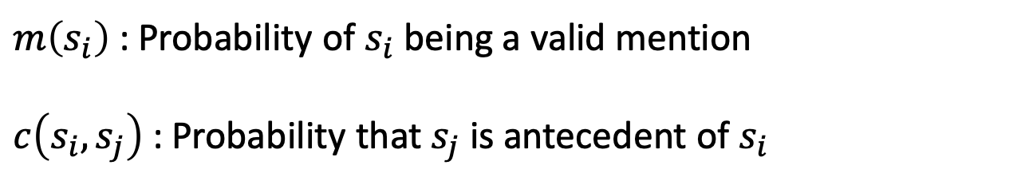
Second step: Coref. Score
For two spans $s_{i}, s_{j}$, their final score consists of three terms
$$s\left(s_{i}, s_{j}\right)=m\left(s_{i}\right)+m\left(s_{j}\right)+c(s_{i},s_{j})$$
Mention
score
Antecedent score
$m\left(s_{i}\right)$: Probability of $s_{i}$ being a valid mention
$c\left(s_{i},s_{j}\right)$ : Probability that $s_{j}$ is antecedent of $s_{i}$
“End-to-end Neural Coreference Resolution”, Lee et. al. (2017)

Slide 27
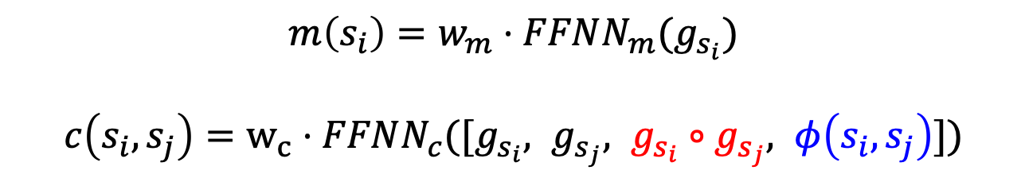
Second step: Coref. Score
Use feedforward neural network to compute final score based on span embeddings from first step
$$m\left(s_{i}\right)=w_{m}⋅FFNN_{m}(g_{s_{i}})$$
$c\left(s_{i},s_{j}\right)=w_{c}⋅FFNN_{c}([g_{s_{i}}, g_{s_{j}}, g_{s_{i}}∘g_{s_{j}}, φ\left(s_{i}, s_{j}\right)])$
Models “Relation between spans”
Additional Features/Constraints not in text.
(Such as the ones we had for feature-based classifier)
“End-to-end Neural Coreference Resolution”, Lee et. al. (2017)

Slide 28
Evaluation
A few popular metrics that have slightly different focus
B-cubed (B³)
MUC
CEAF
….
Most people report the average of the three measure above

Slide 29
Evaluation Metrics #1: MUC F1
Measures the percentage of coreference links (pairs of coreferent mentions) that are correctly predicted
$$Precision =\frac{\# of correctly predicted coreference links}{\# of all predicted coreference links}$$
$$Recall =\frac{\# of correctly predicted coreference links}{\# of all gold coreference links}$$
Notes:
The weight wi for each entity can be set to different values to produce different versions of the algorithm.

Slide 30
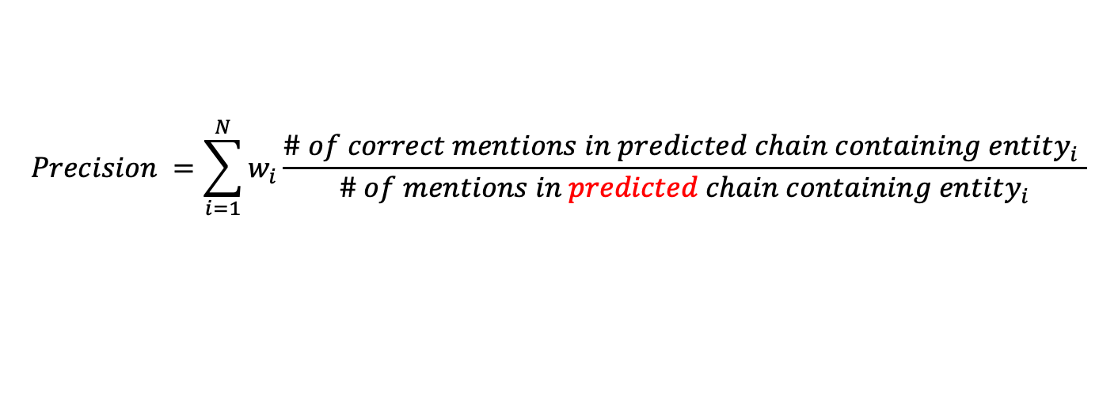
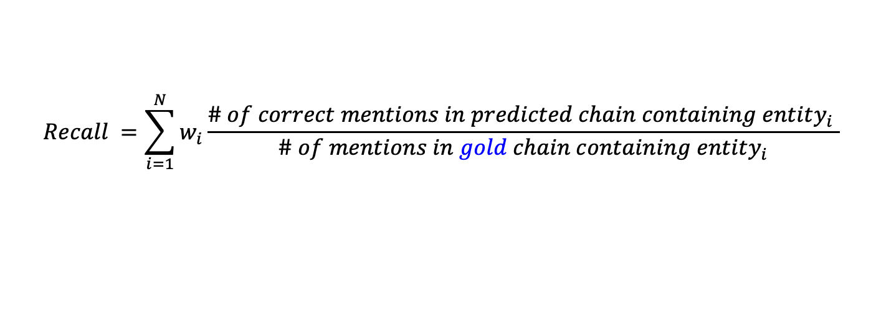
Evaluation Metrics #2: B³
Mention-based metric;
Unlike MUC, B³ gives partial credit if only a subset of mentions are correctly predicted
$$Precision =\sum_{i=1}^{N}{w_{i}}\frac{\# of correct mentions in predicted chain containing entity_{i} }{\# of mentions in predicted chain containing entity_{i}}$$
$$Recall =\sum_{i=1}^{N}{w_{i}}\frac{\# of correct mentions in predicted chain containing entity_{i} }{\# of mentions in gold chain containing entity_{i}}$$
Notes:
The weight wi for each entity can be set to different values to produce different versions of the algorithm.

Slide 31
Is coreference solved?
No. Coreference Resolution is challenging
“Winograd Scheme Challenge”
A list of hard coreference instances that can only be solved via commonsense reasoning
Terry Winograd
“The Winograd Schema Challenge” by Levesque et. al. (2012)

Slide 32
Winograd Schema Challenge
The trophy doesn’t fit in the brown suitcase because it’s
too big. What is too big?
The trophy
The brown suitcase
None of the features we introduced works on this!!
Best Coref. model can only get ~50% accuracy -- No better than random guess!
“A Simple Method for Commonsense Reasoning”, Trinh and Le (2018)

Slide 33
Gender Bias in Coref.
Existing Coref. Model picked up gender stereotypes from training data or pre-trained word embeddings
Model Prediction
The physician hired the secretary because he was overwhelmed with clients
Model Prediction
The physician hired the secretary because she was overwhelmed with clients
“Gender Bias in Coreference Resolution: Evaluation and Debiasing Methods” by Zhao et. al. (2018)

